Slide 1
National storage infrastructures
NeLS/StoreBioInfo, NIRD, TSD
Erik Hjerde
ELIXIR Norway

Slide 2



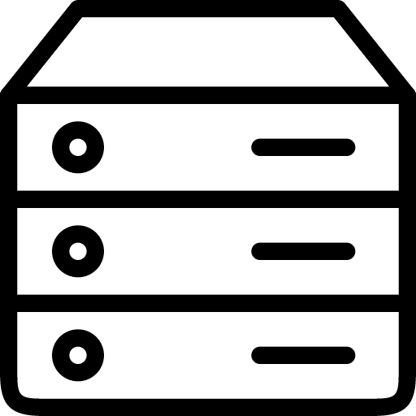


Data storage – from the researcher perspective
DATA
DATA STORAGE
EXPERIMENT
DATA DEPOSITION
METADATA
DATA ANALYSIS

Slide 3
Data storage – from the researcher perspective
DATA
DATA STORAGE
EXPERIMENT
DATA DEPOSITION
METADATA
DATA ANALYSIS

Slide 4
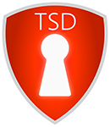
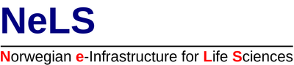

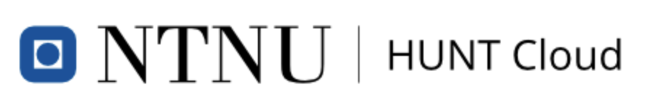
National storage infrastructures
Non-sensitive data
Sensitive data
DATA STORAGE
DATA ANALYSIS

Slide 5

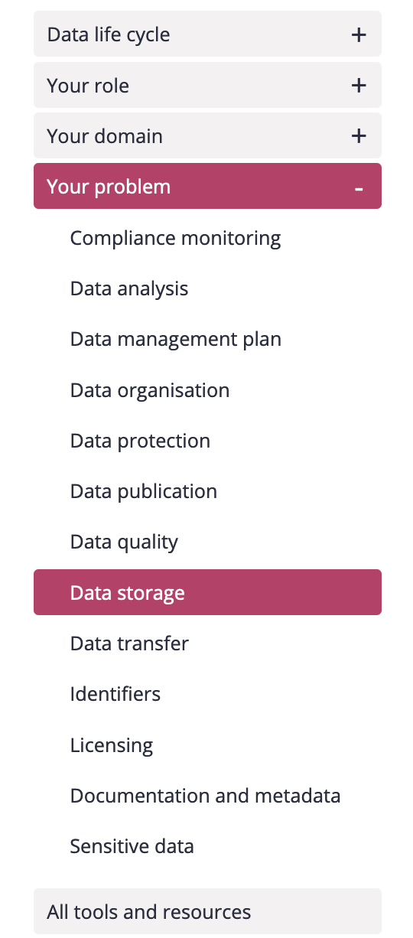
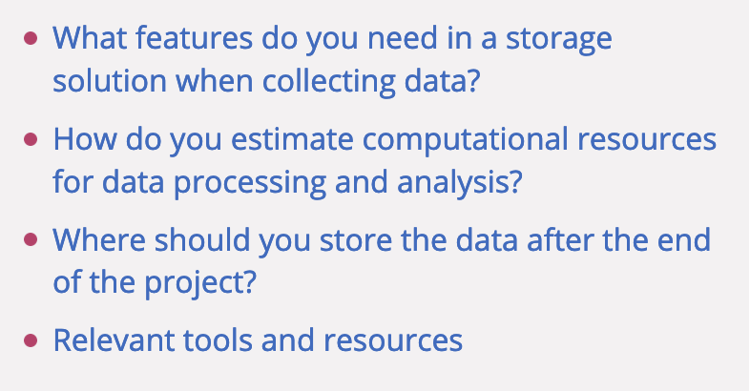
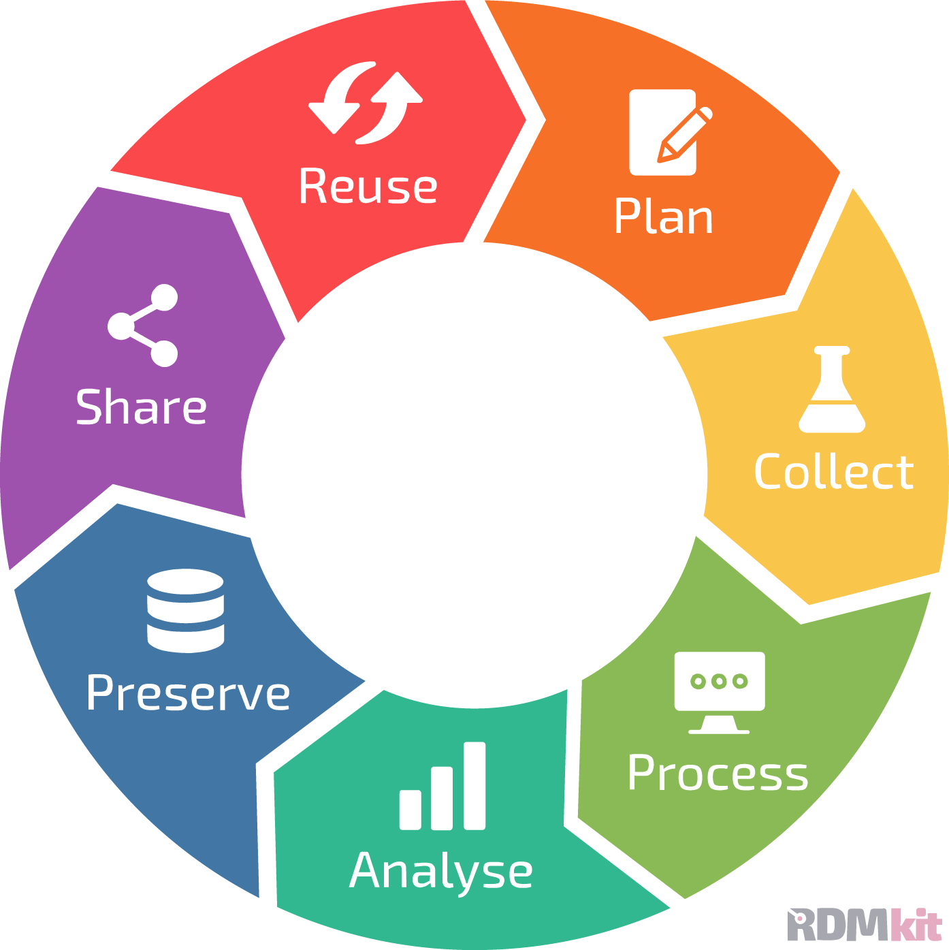
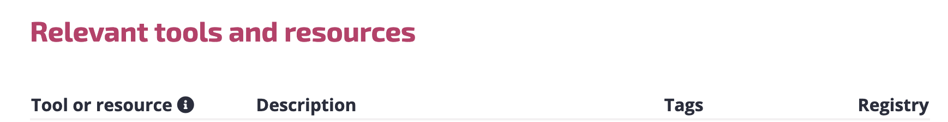
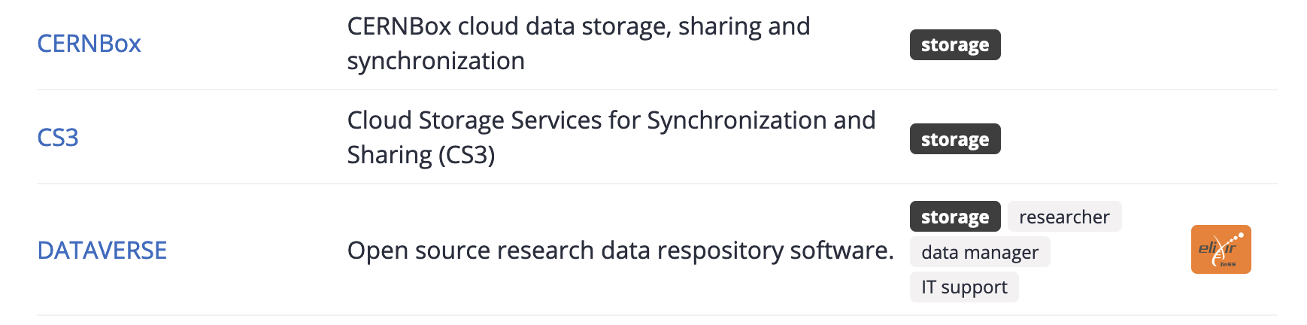
Data storage – General considerations
The ELIXIR Research Data Management kit
Link to RDMkit storage: https://rdmkit.elixir-europe.org/

Slide 6
Data storage – from the researcher perspective
DATA
DATA STORAGE
EXPERIMENT
DATA DEPOSITION
METADATA
DATA ANALYSIS

Slide 7
Data storage in NeLS and StoreBioInfo (SBI)
Norwegian e-infrastructure for Life Sciences - developed and operated by Elixir Norway
NeLS in general
Available to all Norwegian researchers
Enable collaborative projects
Multiple storage layers
Integrated with compute
Multiple permission roles - shared data
Free of charge*
Support for data deposition
User support: Elixir Norway helpdesk
Type of data
Non-sensitive data
Support multiple data types
SEEK integration for metadata
NeLS
DATA
DATA STORAGE
DATA DEPOSITION
METADATA
DATA ANALYSIS

Slide 8
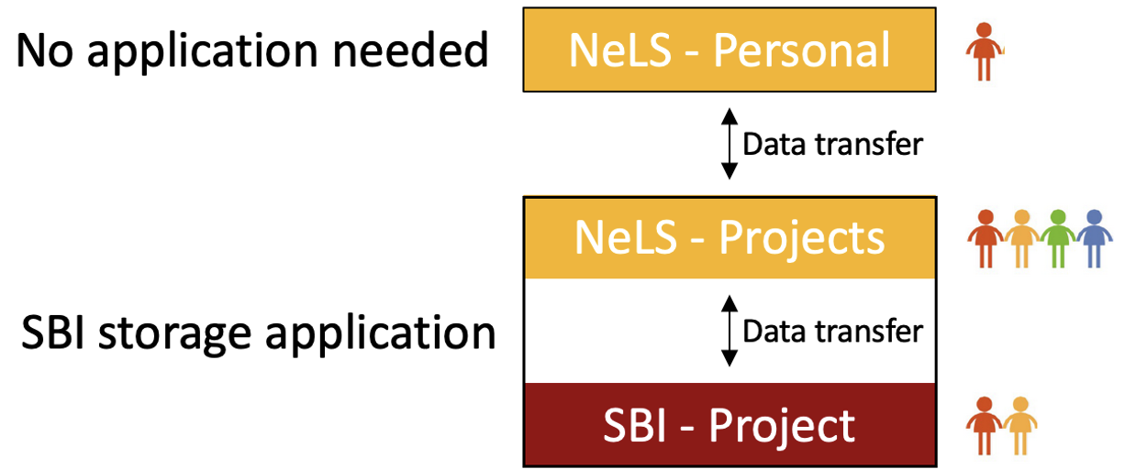
Data storage in NeLS/SBI – How to get access
Storage application needed for projects where data is shared by many users
Access via FEIDE user or NeLS idp can be made for non-FEIDE users
Free storage < 10 TB
Apply for storage: contact@bioinfo.no
Wiki for usage: https://nels-docs.readthedocs.io/en/latest/

Slide 9
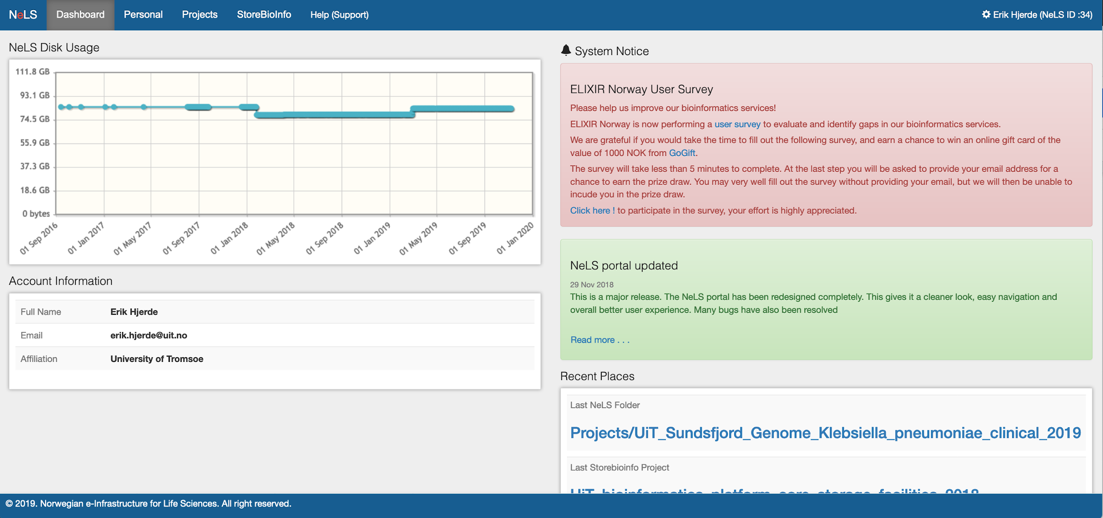
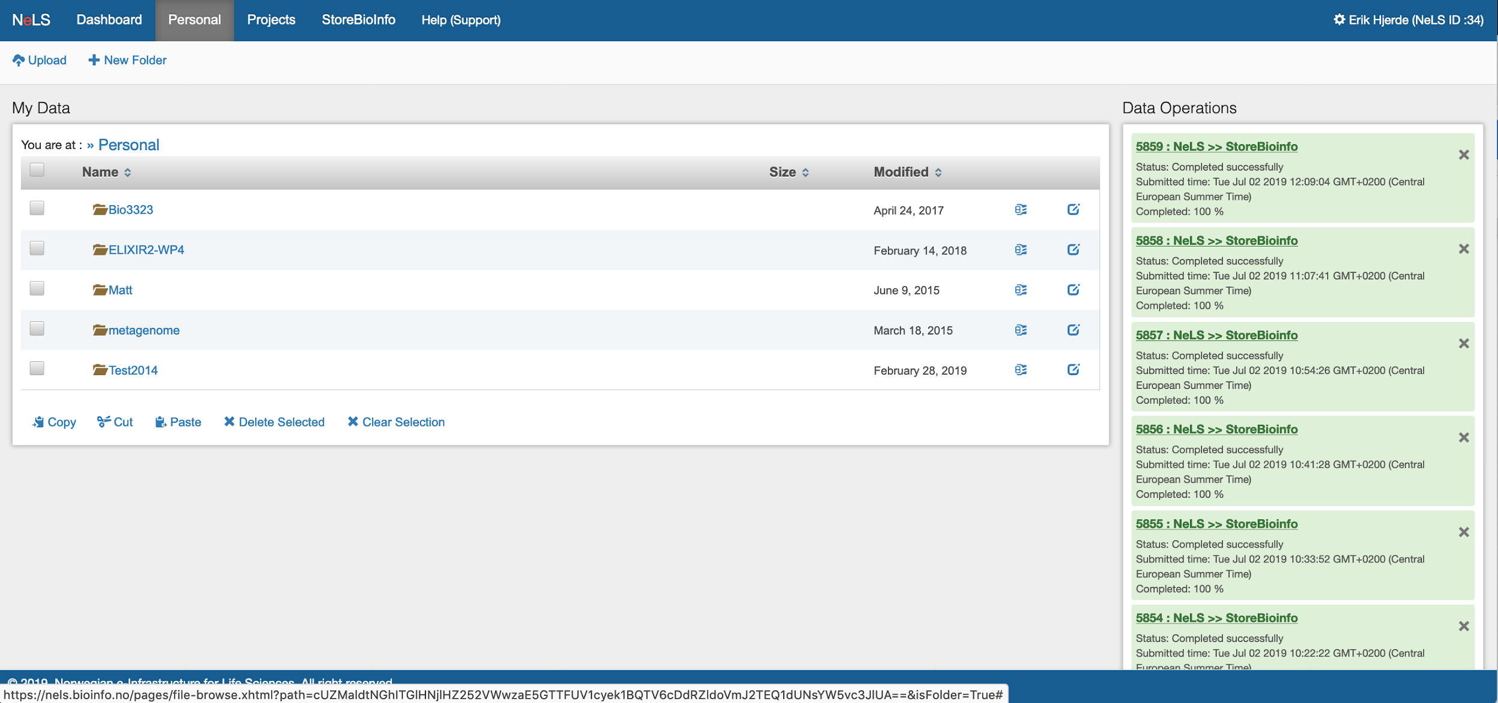
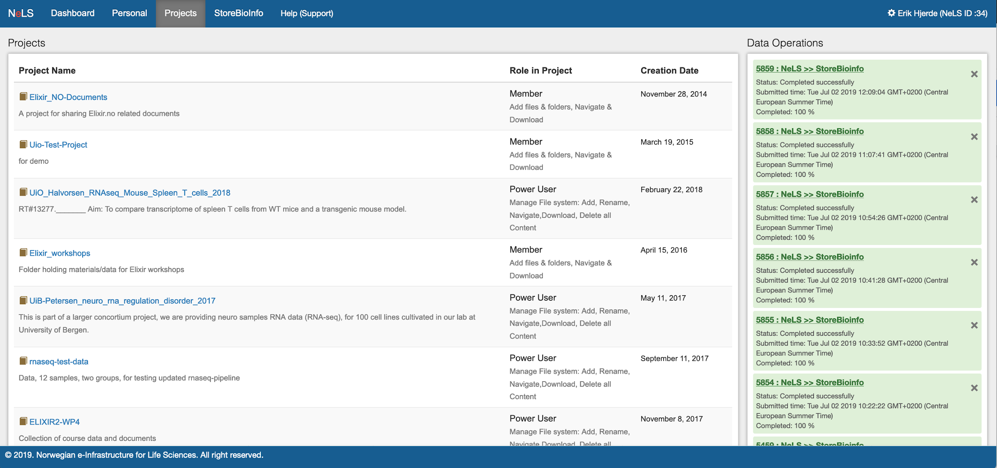
Access data storage in NeLS
The NeLS portal can be accessed via a web browser at https://nels.bioinfo.no/ or via a file transfer tool (e.g. Filezilla) or the command line SCP

Slide 10
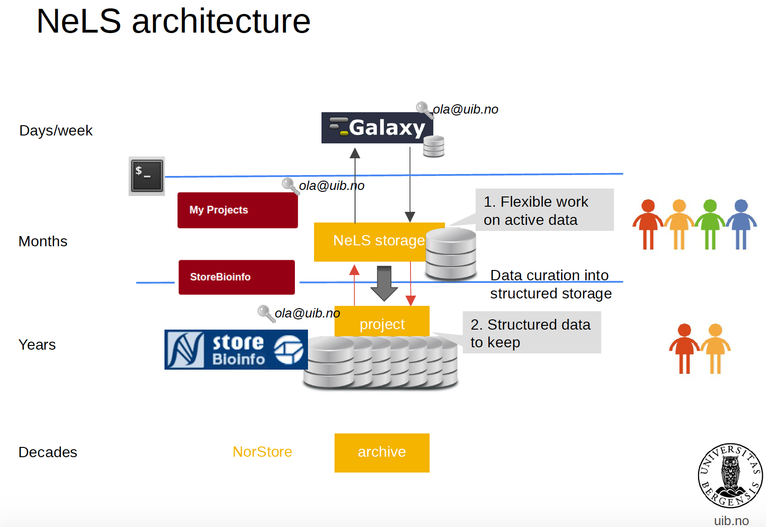






NeLS architecture
Research data archive

Slide 11



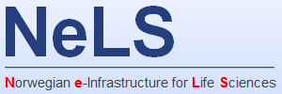
SEEK - sharing heterogeneous scientific research datasets, models or simulations, processes and research outcomes
The SEEK platform is a web-based tool for organising and storing data, and for exploring and annotating data
Norwegian users can link datasets stored in NeLS to a SEEK project using FAIRdom hub
Integrated
Datasets
eg. FASTQ fiiles
Metadata
(and datasets)
Notes:
Typically, organise the project with associated metadata (e.g. how sequencing libraries were prepared) in SEEK
Link datasets stored in NeLS to the SEEK project

Slide 12
Data storage in NIRD
National e-Infrastructure for Research Data - owned and operated by UNINETT Sigma2
NIRD in general
Available to all users with account
Enable collaborative projects
Integrated with compute
Multiple permission roles - shared data
Free of charge*
User support: Metacenter support
Type of data
Non-sensitive data
Support multiple data types
All type of scientific data*
NIRD
DATA STORAGE
DATA ANALYSIS
Notes:
Available to any scientific discipline

Slide 13
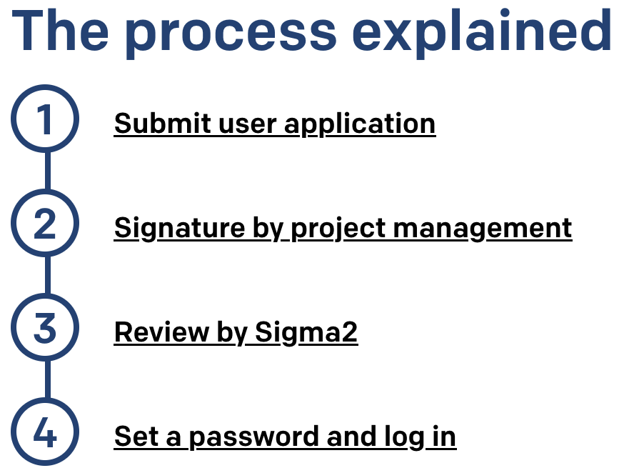
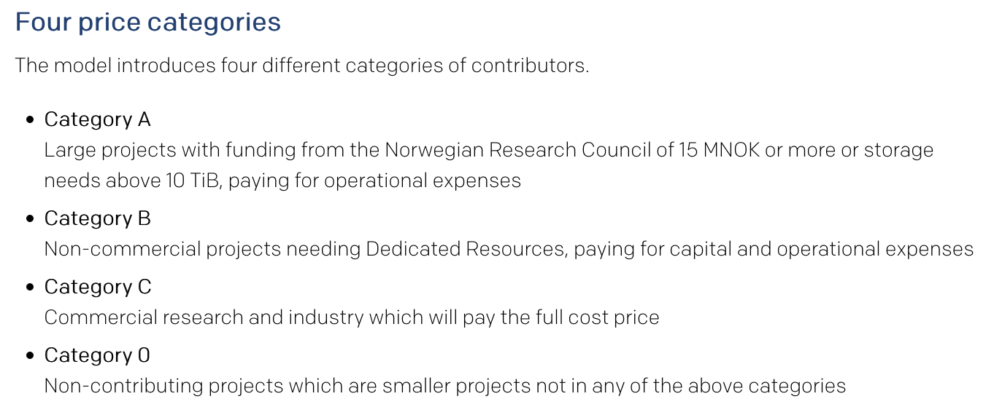
Data storage in NIRD – How to get access
Apply for a UNINETT SIGMA2 user
Apply for a storage quota - Free storage < 10 TB
Apply for user account: https://www.metacenter.no/user/application/
Apply for storage: https://www.sigma2.no/apply-e-infrastructure-resources
Wiki for usage: https://documentation.sigma2.no/index.html
Contribution model: https://www.sigma2.no/user-contribution-model

Slide 14
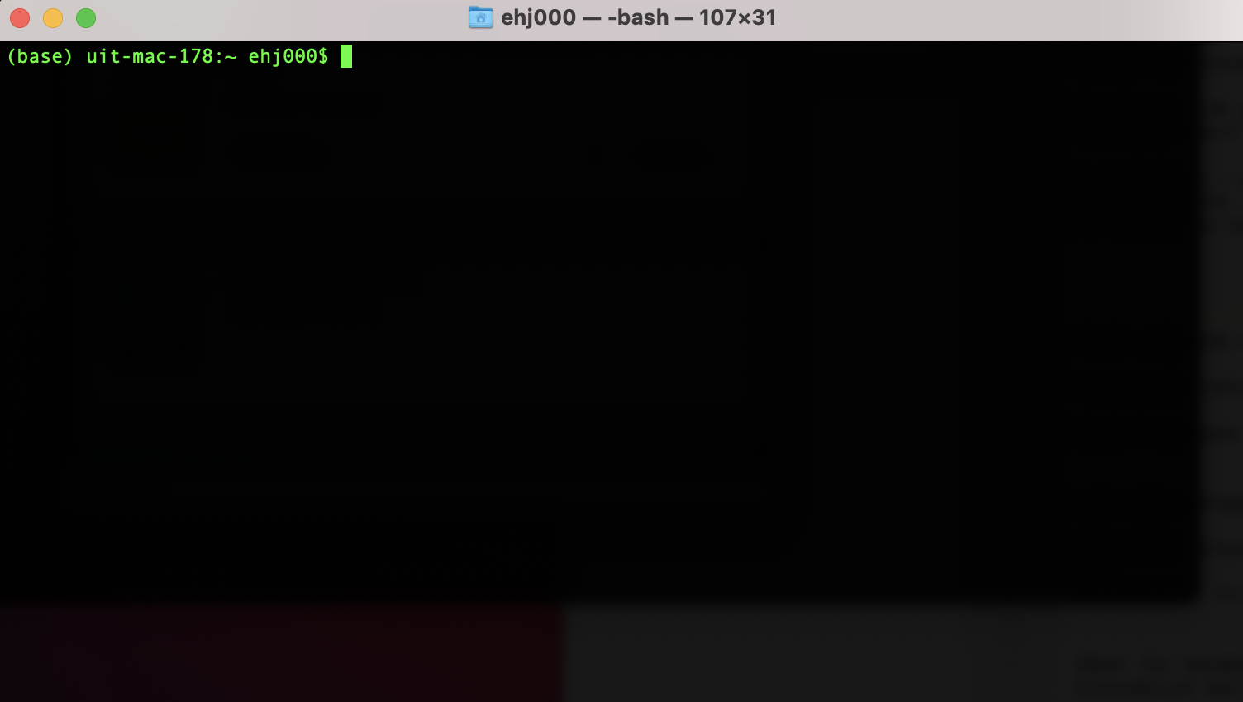
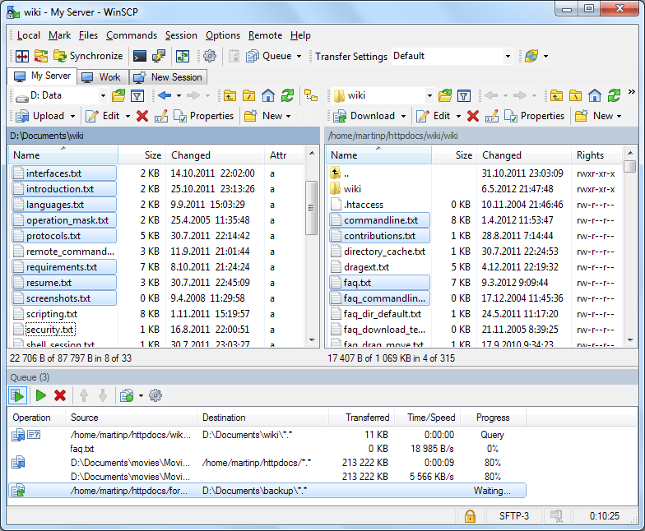
Access data storage in NIRD
The NIRD storage can be accessed via the command line using SSH
Data import/export via command line tools such as SCP or SFTP or other file transfer tools (e.g. WinSCP)

Slide 15
Sensitive data storage
Non-sensitive data
Sensitive data
DATA STORAGE

Slide 16
Data storage in TSD
National service for sensitive data - developed and operated by UiO
TSD in general
Available to all users with account
Enable collaborative projects
Integrated with compute
Multiple permission roles - shared data
User support: Tech and admin support
Type of data
Sensitive data
Support multiple data types
DATA STORAGE
DATA ANALYSIS
Notes:
Available to any scientific discipline

Slide 17
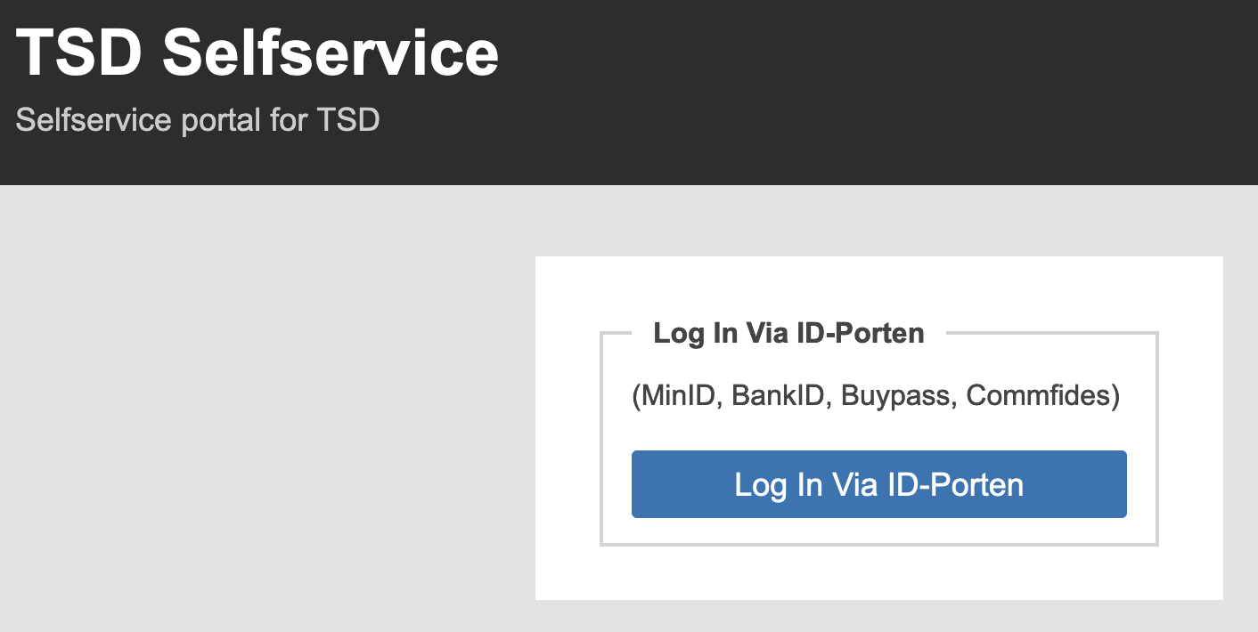
Data storage in TSD – How to get access
Apply for a project – need to document ethical approval (e.g. from REC)
Generate a TSD user – require 2-factor authentication
Payment models for storage
Apply for a TSD project through ELIXIR.NO:
ELIXIR Norway has a quota in TSD that, and users can get subsidised quota through ELIXIR in TSD
Generate user account: https://selfservice.tsd.usit.no/
Apply for project: https://www.uio.no/tjenester/it/forskning/sensitiv/hjelp/start/registrer.html
Wiki for usage: https://www.uio.no/tjenester/it/forskning/sensitiv/hjelp/start/index.html

Slide 18
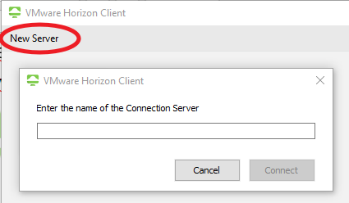
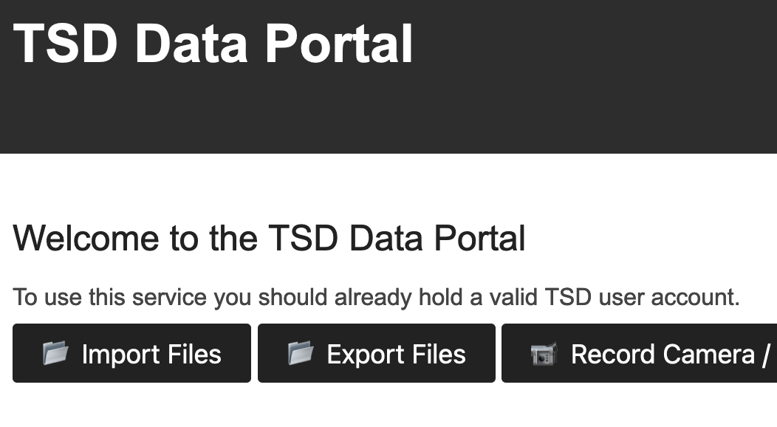
Access to data storage in TSD
The TSD storage can be accessed via VMware Horizon + 2-factor authentication
Import/export data via the web file upload service

Slide 19


Where should I store and share my life science data?
 | Sensitive data | Direct transfer from data producer | Web portal access* | Command line access | Shared projects | Integration for metadata | Support for data deposition | Free of charge
NeLS/SBI
NIRD
TSD
*Direct access to the data and project management through the web browser

Slide 20


Example - Data flow/handle using ELIXIR Norway
DATA
DATA STORAGE
EXPERIMENT
DATA DEPOSITION
METADATA
DATA ANALYSIS

